Slide 1
A Privacy-Preserving-Oriented DNN Pruning and Mobile Acceleration Framework GLSVLSI ’20

Slide 2
Background
Data Privacy
Most are based on the assumption that the training dataset is available.
The training data should be kept secret in commercial applications.
Weight Pruning
The ever-increasing model size and the computing demand->restrict the deployments of DNNs on mobile and edge devices with limited capacities.
Weight pruning of deep neural networks has been proposed to satisfy the limited storage and computing capability of mobile edge devices

Slide 3
Motivation
a privacy-preserving oriented DNN pruning and mobile acceleration framework.
The algorithm level: a DNN model compression entity prunes the pre-trained models provided by users with pattern-based sparsity without the usage of any information about the private training.
The compiler level: corresponding pattern-enabled compiler optimizations are used. After retraining the compressed model, users can achieve real-time inference without accuracy loss.

Slide 4
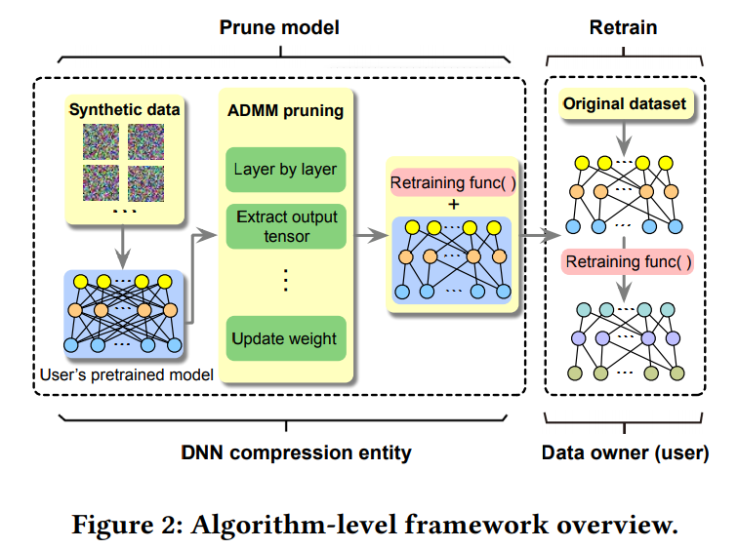
Algorithm Overview

Slide 5
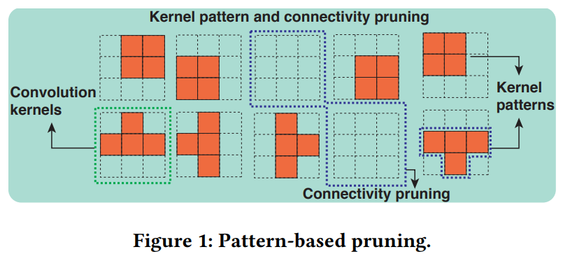
Algorithm Overview
Goal : Find specific sparse patterns for the kernels without the usage of the original dataset.
Categories: Kernel Pattern Pruning + Connectivity Pruning

Slide 6
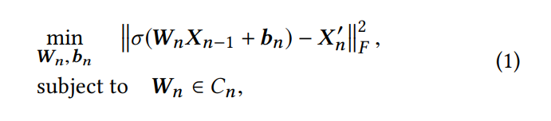
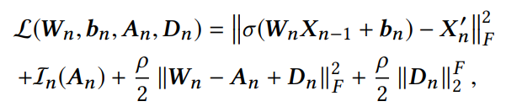

ADMM-based Kernel Pattern Pruning
How:
Layer n takes the output Xn−1 from the previous layer, an output volume Xn = σ(WnXn−1 + bn)
measure the Frobenius norm between the original output volume X′n of user’s pre-trained model and the output Xn.
Formulation:
ADMM-based
an indicator function In(Wn), that is zero when the constraint Wn ∈ Cn is satisfied, but +∞ otherwise.
Dn is the dual variable
first subproblem
second subproblem

Slide 7
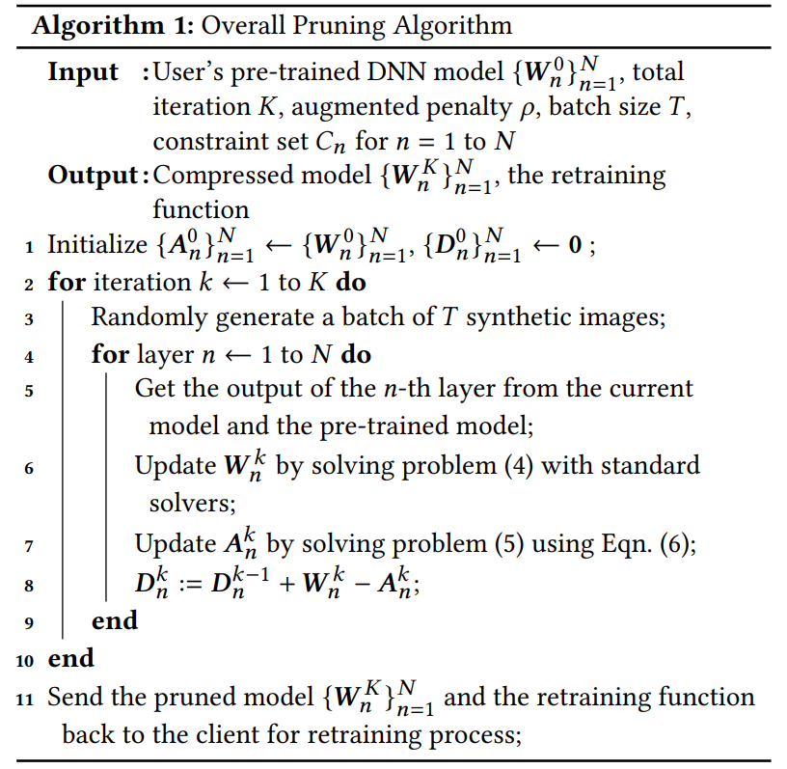
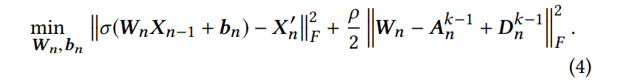

Connectivity Pruning

Slide 8
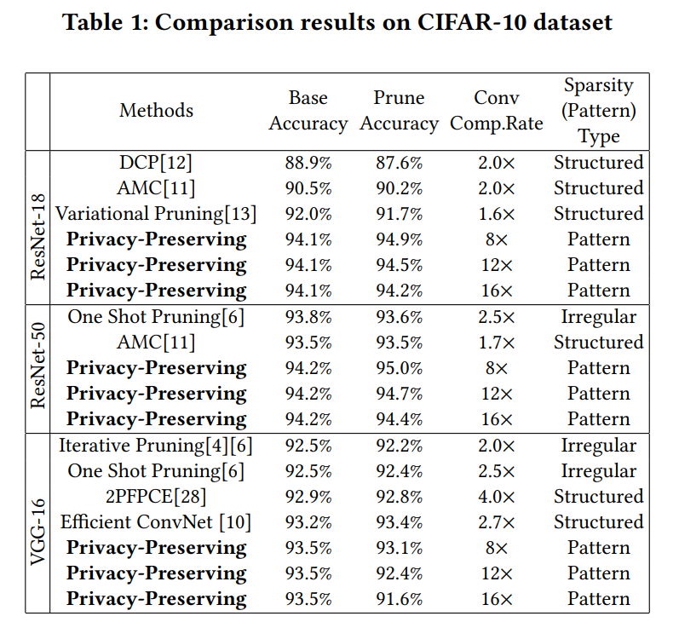
EXPERIMENTAL RESULTS
Environment:
NVIDIA GTX 1080Ti GPU and three NVIDIA RTX 6000 GPUs.
ResNet-18, achieve a 16× compression rate and 94.2% accuracy after pruning.
ResNet-50, achieve a 16× compression rate and 94.4% accuracy after pruning.
VGG-16, with a 16× compression rate and 91.6% accuracy.

Slide 9
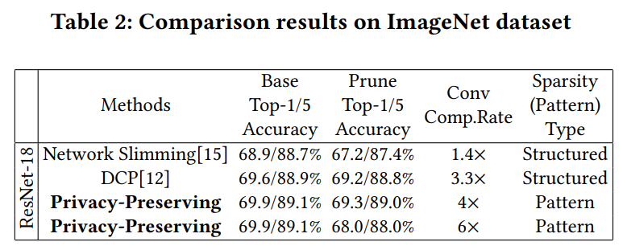
EXPERIMENTAL RESULTS
ResNet-18. achieve a 4× compression rate with almost no top-5 accuracy drop on ResNet-18, which is much better than Network Slimming and DCP.
further reach a 6× compression rate with 88.0%

Slide 10
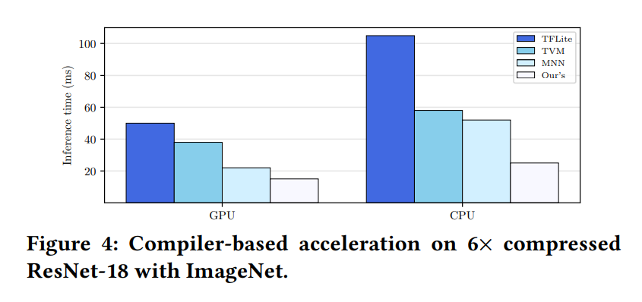
Performance Evaluation on Mobile Platform
Environment: a Samsung Galaxy S10 cell phone with the latest Qualcomm Snapdragon 855 mobile platform that consists of a Qualcomm Kryo 485 Octacore CPU and a Qualcomm Adreno 640 GPU.
The testing model is ResNet18 with a 6× compression rate on ImageNet dataset.
On CPU, the proposed framework achieves 4.2× speedup over TFLite, 2.3× speedup over TVM, and 2.0× speedup over MNN.
On GPU, achieves 3.3× speedup over TFLite, 2.5× speedup over TVM and 1.4× speedup over MNN.

Slide 11
Person View
Contribution:
accelerate inference.
To incorporate the advantages of both structured pruning and non-structured pruning
Innovative
formulate the problem of pattern-based pruning without the usage of the original training dataset as an optimization problem and solve it successfully with an extension of the powerful ADMM.
Difference when compared with our framework:
Channel Prune is done on Cloud.
Inference is done on Edge.
When the model is pruned, it can not change. If the data changes, the whole process should be redone.

Slide 12
谢 谢！

